Slide 1




Injury & Accident Reporting
Allen County Parks
2019

Slide 2
When????
Anytime an employee is injured on the job
Anytime a park patron is injured and reports it to park staff
Anytime property is damaged whether it be park property or private property
Anytime a park employee is involved in a vehicular accident in a County Park Vehicle

Slide 3
Who????
YOU !!!!!!!!
Most forms indicate “Supervisor” or “Department Head” for signatures. If you are on the scene YOU ARE THE SUPERVISOR regardless of your title!!!!!

Slide 4
Where are the forms?????
Forms are located at both Nature Centers at the Reception desks
Forms are located in both Maintenance Barns
Forms are located in all Park Vehicles
Forms are also located in PDF form on the Park website under the “Employees Only” page which can be accessed under the “About Us” dropdown menu
Password is “employee”

Slide 5
The LINK
http://allencountyparks.org/about/allen-county-parks-staff/employees-only/
Click on the form where it says “Click Here” and it will open in a new tab or window.
These are pdf files so hovering over it with the mouse should bring up “print”, or “download” icons in the upper right hand corner.

Slide 6
How????
We will go through each form in upcoming slides but…
Fill out each form completely
There are times when the Sheriff should be called CALL THEM
If you are the only one on the scene when all is completed contact your Supervisor for further instructions

Slide 7
Patron / Incident Report
When to file this report:
Incident or accident occurs on County park property to person not employed by the County
Damage or vandalism (whether private or park property)
Theft of property (park or private)
Vehicle accidents (privately owned vehicle)

Slide 8
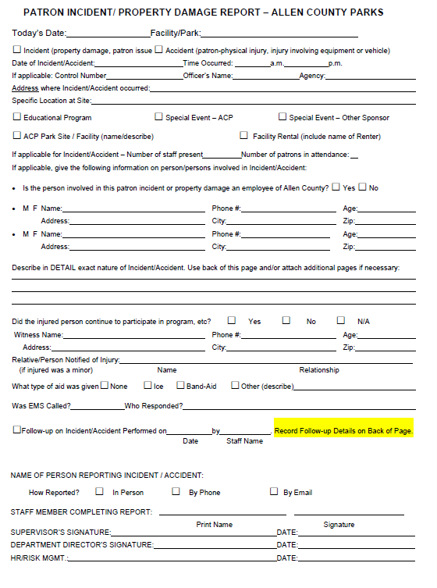
Fill out all information, if property damage to private or park property then we MUST contact Sheriff.
Check the appropriate box
Fill out information on person involved. Circle M or F
Describe in as much detail as possible what happened.
If witness fill out info.
If you notified anyone else please list.
If any first aid was given please note it as well as if an EMS was called and which jurisdiction arrived.
This line will be filled out by Supervisor or Supt.
Fill out name of person who reported the injury and then complete your name and sign.

Slide 9
Workmens Compensation Injury Report Packet
This report is sometimes referred to as First Report of Injury.
This packet is ONLY to be use if this is an Allen County employee injury. Patrons and users should fill out the previous form.
This packet has a number of pages. We will go through them now…

Slide 10
The first page is instructions on how to fill out the packet and is fairly self explanatory.
Second page is called INDIANA WORKER’S COMPENSATION FIRST REPORT OF EMPLOYEE INJURY, ILLNESS. This is the most important of this packet.
Third page is the Supervisors Incident Investigation and may be filled out later if not on-site. If you are the Supervisor FILL IT OUT!
Fourth page is Medical Authorization to Treat and is only to be used if employee is going to Redi-Med. Fifth and sixth pages are maps of locations

Slide 11
Fill out all employee information
These two areas are filled out on the printed forms or will be filled out by Human Resources
Fill out all known information in this area. Don’t worry about Type Code and Part Code.

Slide 12
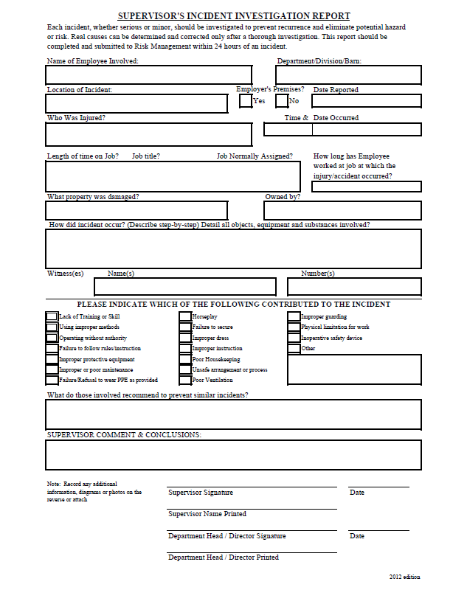
Fill out all information on this form if you are the Supervisor or asked by Supervisor to fill it out.
Most of the information needed here is on the first report but additional information is required.
Supervisor please fill out the necessary information and sign and date.
Place completed form in the Superintendents mailbox or fax to Fox Island.

Slide 13
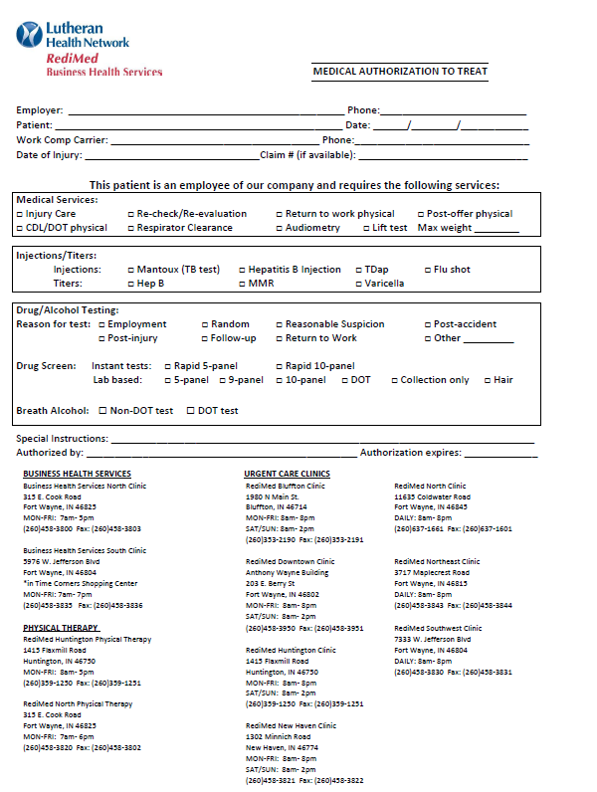
This form is required if the employee requires medical attention and is being taken to Redi-Med.
Fill in Employer: Allen County Government – Parks
Our phone number, patient (employee) name, date. Don’t worry about Work Comp Carrier or phone on that line. Fill in date of injury.
In this box you would check Injury Care
Nothing in this box required
Unless instructed by Superintendent, Human Resources or Sheriff leave this blank.
Under Authorized by: Sign your name
Insert that days date in Authorization expires:

Slide 14
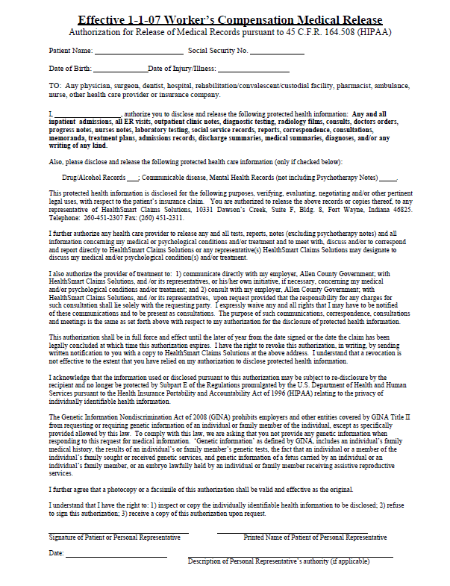
The seventh page is the “Worker’s Compensation Medical Release”
Employee must fill out this form as it is a HIPAA form. Employee must sign and date or have his Personal Representative sign and date

Slide 15
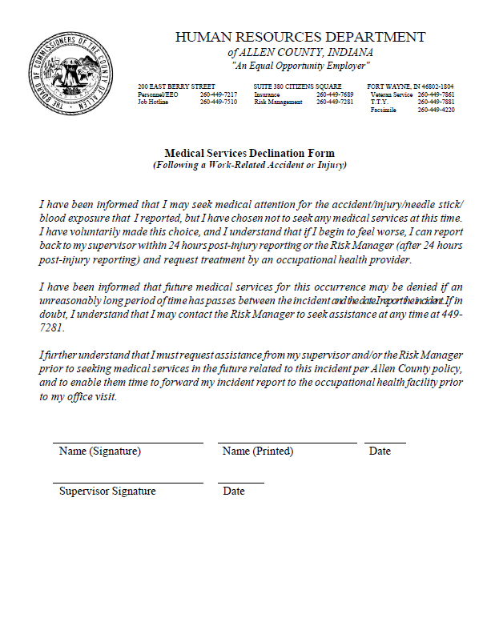
The eighth and final page of this report packet is the “Medical Services Declination Form”.
This form must be filled out by the employee if they decline medical services for their injury. Employee should sign, print name and date.
Supervisor must sign and date as well.

Slide 16
Allen County Vehicle Accident Reporting Form
Also known as the Tri Fold and should be in the vehicles glovebox
These should be filled out if a County Vehicle is involved in accident no matter how small!!!
Instructions are provided.
Fill out this form in its entirety!!!
There are NO EXCPETIONS TO CONTACTING COUNTY COMMUNICATIONS (SHERIFF) if you are involved in a vehicular accident!!

Slide 17
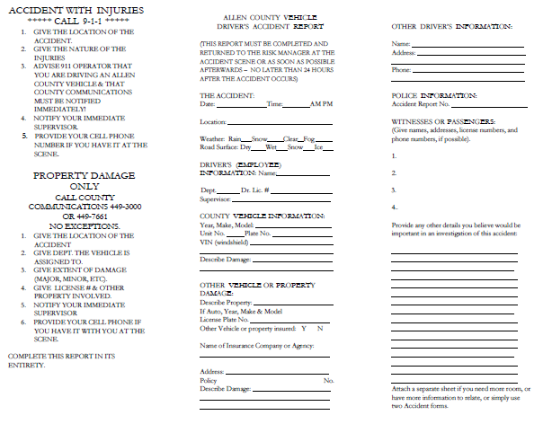
Instructions – Contact Supervisor as well
Back of form has additional information required

Slide 18
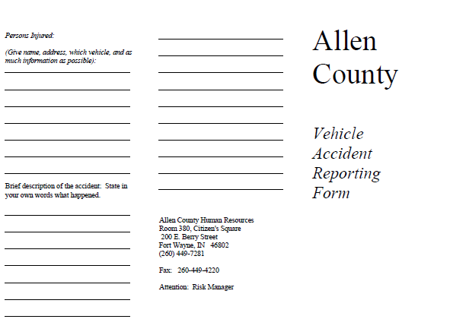
Fill out all information on this page as well.

Slide 19
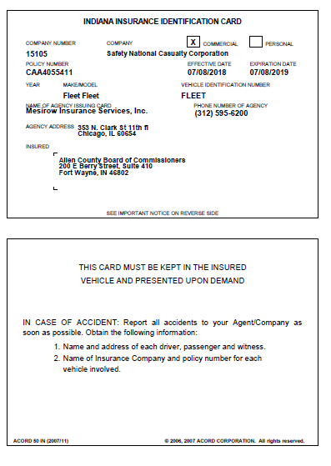
Allen County Fleet ID card
This card should be printed out and kept in all Park (County) vehicles.
There is nothing to be filled out on this but will be needed if vehicle is involved in an accident.

Slide 20
That’s it!! Good job!!
The main thing to remember with injuries and accidents is to remain calm, get help especially if medical attention is required!
Contact your Supervisor, Park and Education Manager, or the Superintendent if necessary.
They can all be reached on their cell phones. Leave a message if they do not answer!!
Fox Island Park & Education Manager – 437-7281
Metea Park & Education Manager – 433-5882
Superintendent – 438-1452
Other numbers are listed on the phone list available on the website on the Employees Only page.

