Slide 1

Driving safety
Defensive Driving

Slide 2
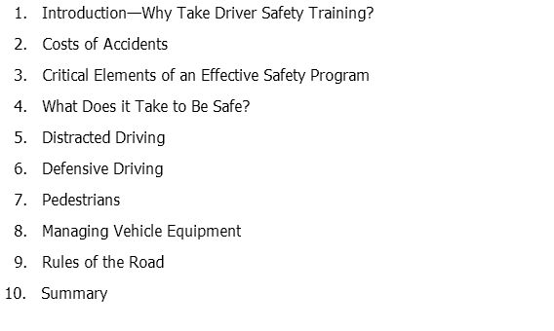
Course Outline –
Driver Safety

Slide 3
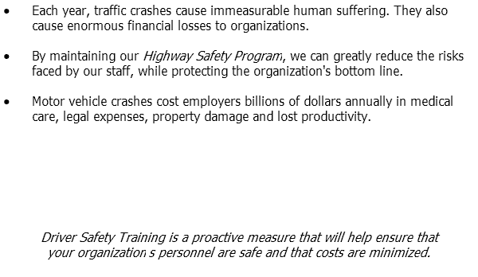
Why Take Driver Safety Training?

Slide 4
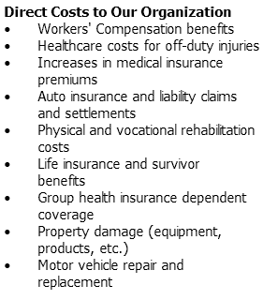
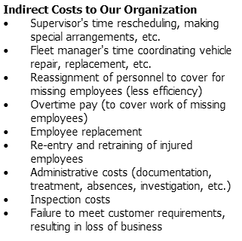
Costs of Accidents

Slide 5
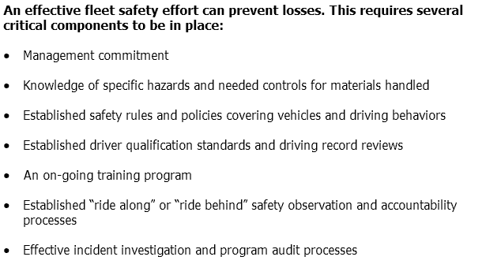
Critical Elements of an Effective Safety Program

Slide 6
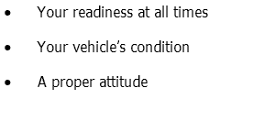

What Does it Take to Be Safe?

Slide 7
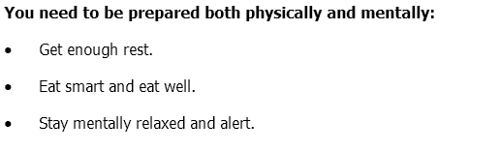
What Does it Take to Be Safe?

Slide 8
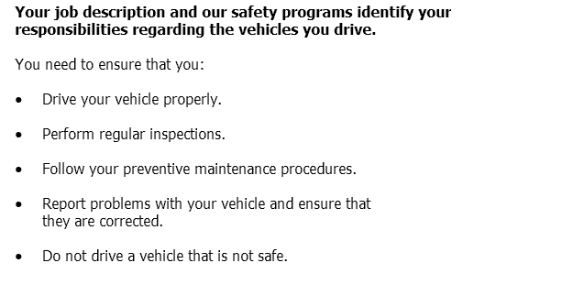
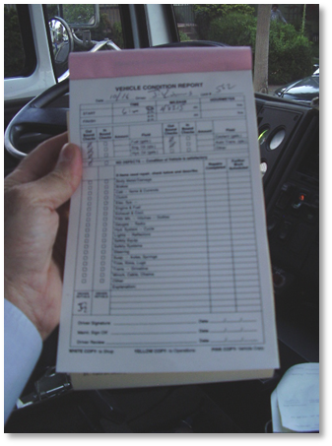
What Does it Take to Be Safe?

Slide 9
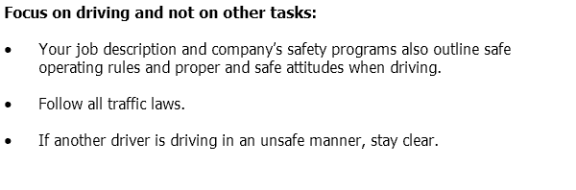
What Does it Take to Be Safe?

Slide 10
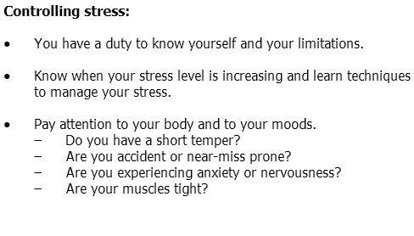

What Does it Take to Be Safe?

Slide 11
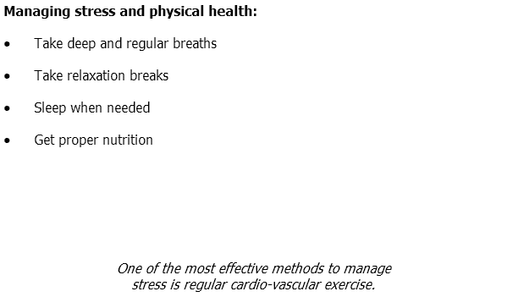

What Does it Take to Be Safe?

Slide 12
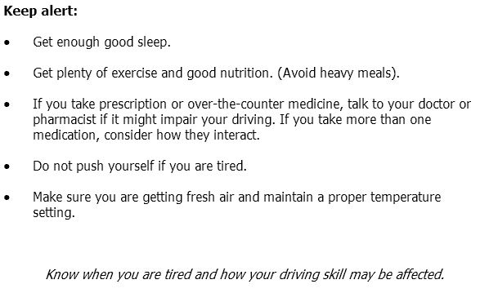
What Does it Take to Be Safe?

Slide 13
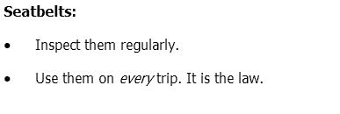
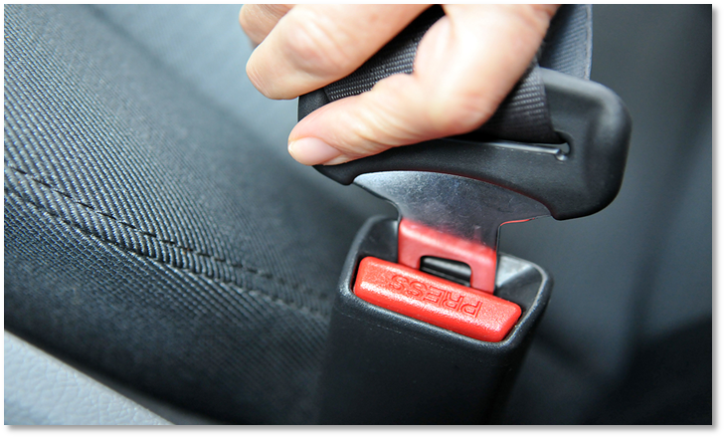
What Does it Take to Be Safe?

Slide 14
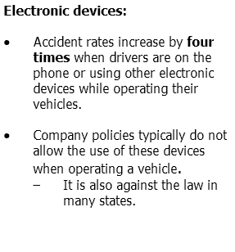
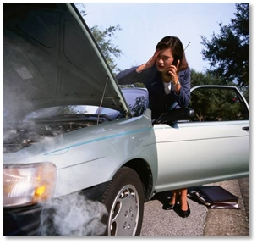
What Does it Take to Be Safe?

Slide 15
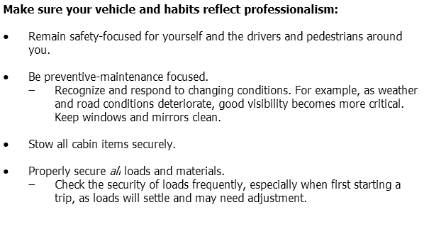
What Does it Take to Be Safe?

Slide 16
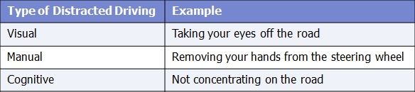

Distracted Driving

Slide 17
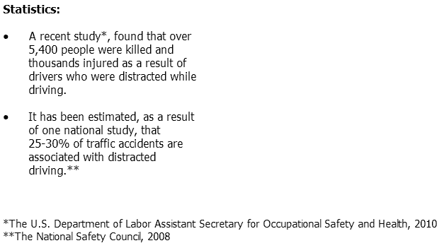
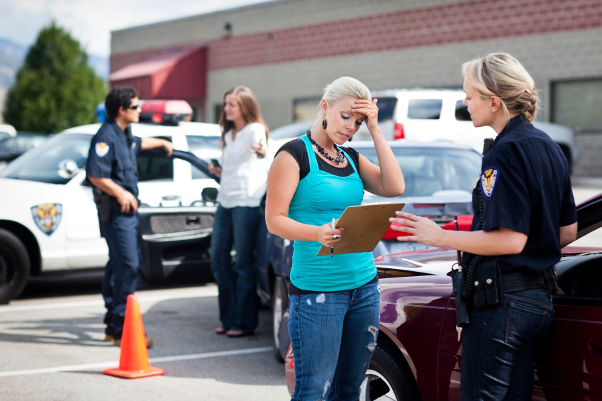
Distracted Driving

Slide 18
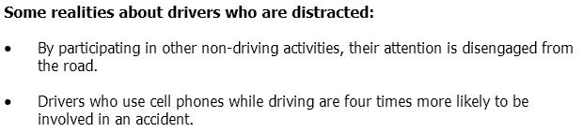

Distracted Driving

Slide 19
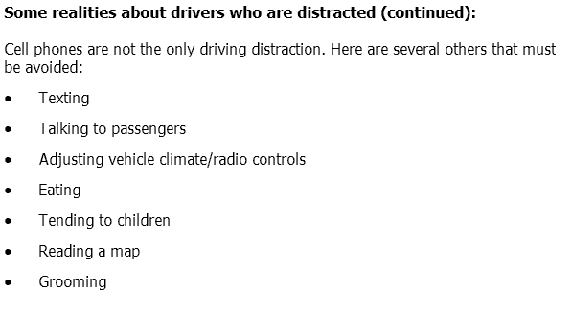
Distracted Driving

Slide 20
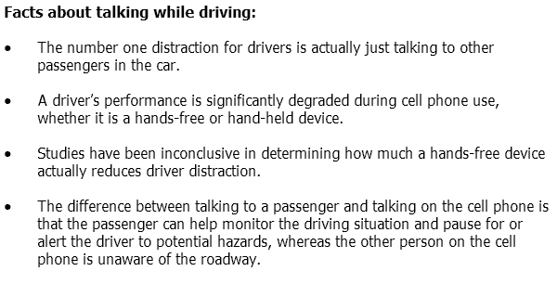
Distracted Driving

Slide 21
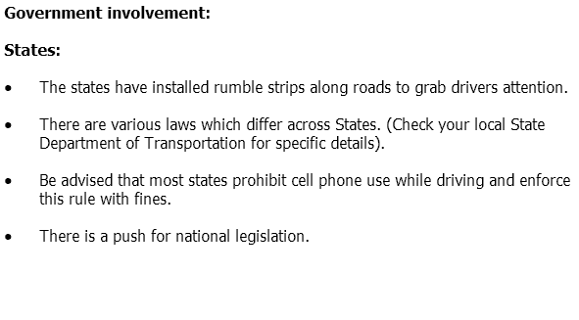
Distracted Driving

Slide 22
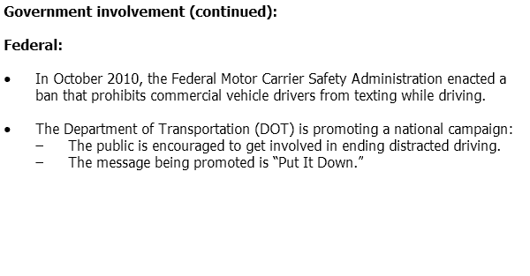
Distracted Driving

Slide 23
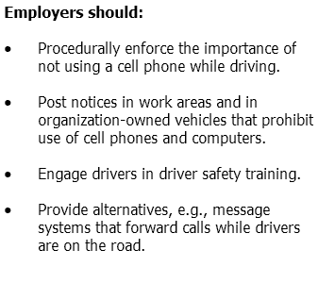

Distracted Driving

Slide 24
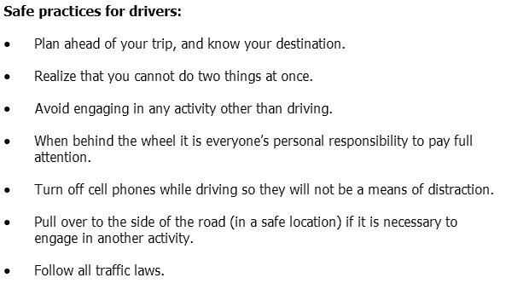
Distracted Driving

Slide 25
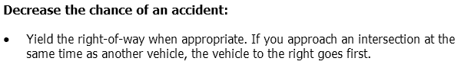
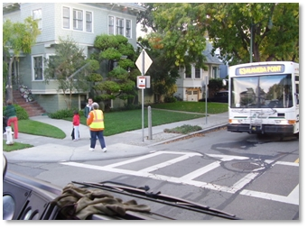

DEFENSIVE Driving

Slide 26
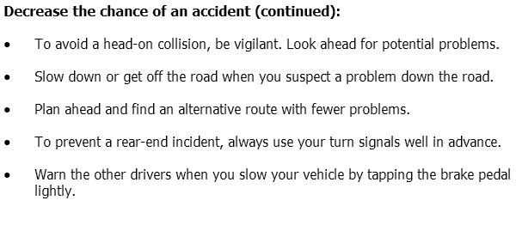
DEFENSIVE Driving

Slide 27
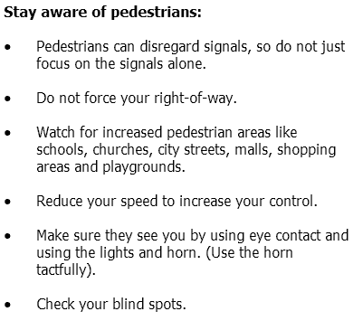
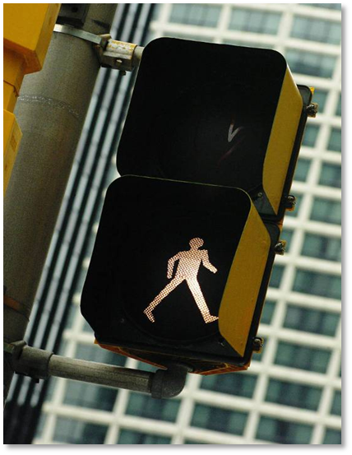
Pedestrians

Slide 28
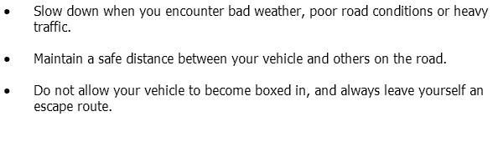
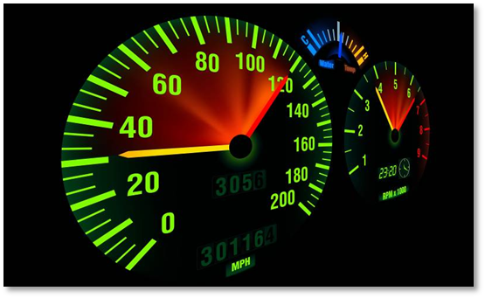
Managing
Vehicle Equipment

Slide 29
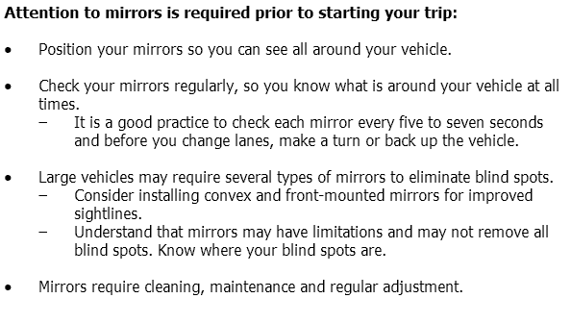
Managing
Vehicle Equipment

Slide 30
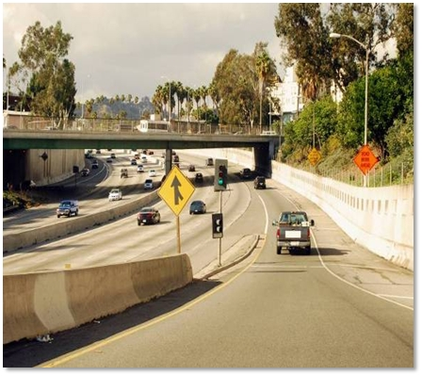
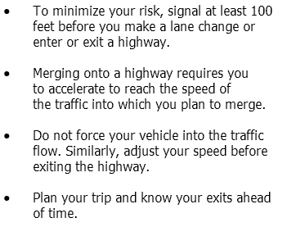
Rules of the Road

Slide 31
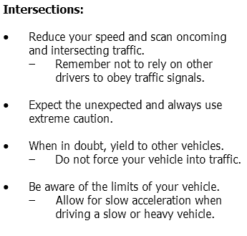
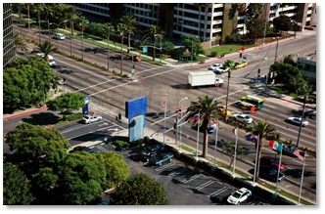
Rules of the Road

Slide 32
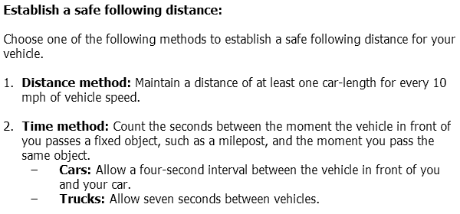
Rules of the Road

Slide 33
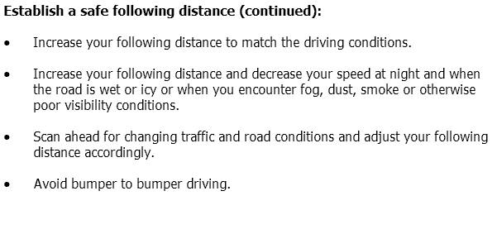
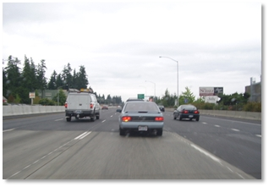
Rules of the Road

Slide 34
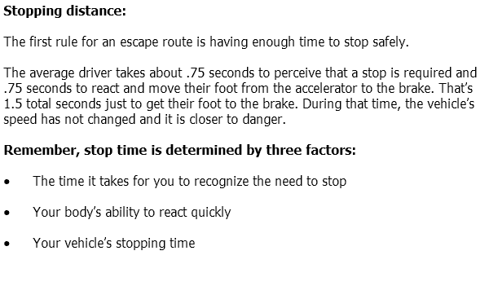
Rules of the Road

Slide 35
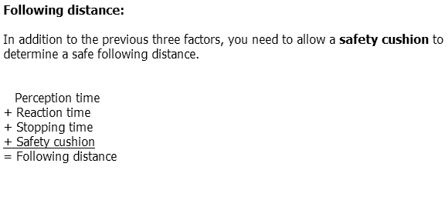
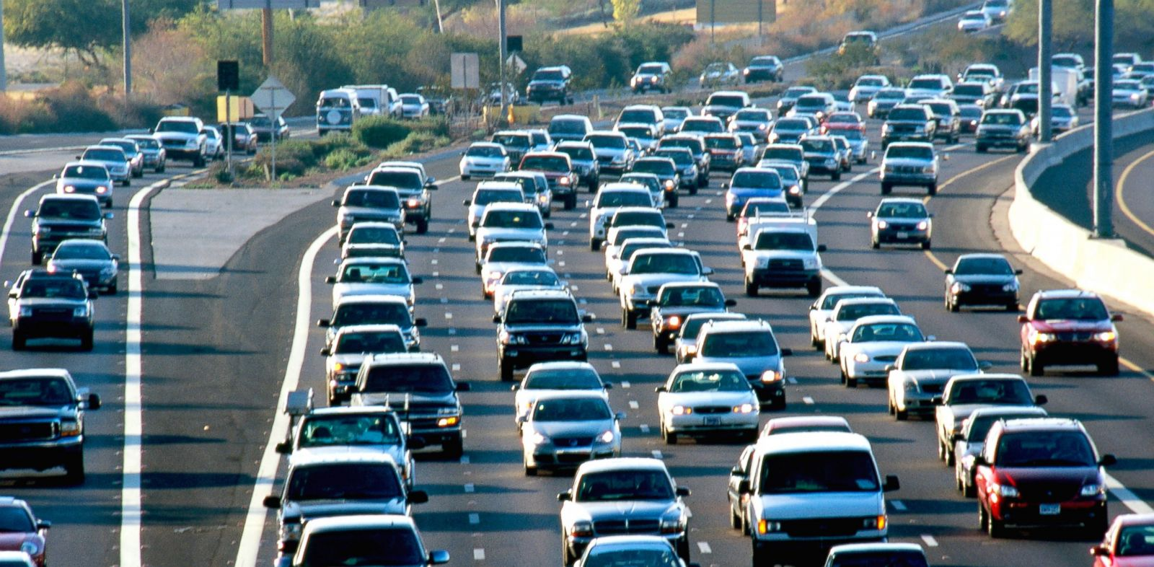
Rules of the Road

Slide 36
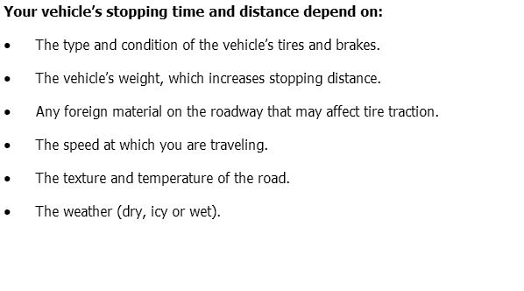
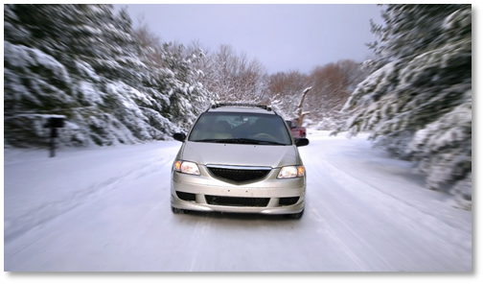
Rules of the Road

Slide 37
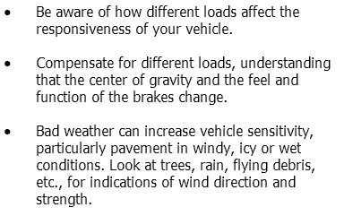

Rules of the Road

Slide 38
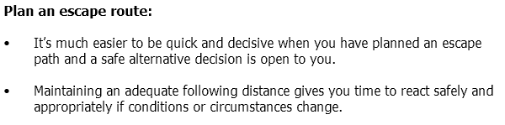

Rules of the Road

Slide 39

Rules of the Road

Slide 40

Rules of the Road

Slide 41


Rules of the Road

Slide 42

Rules of the Road

Slide 43


Rules of the Road

Slide 44


Rules of the Road

Slide 45

Summary

Slide 46
Summary
Congratulations! You have completed Driver Safety.
Please be sure to complete the paper exam!
Thank you for your participation!

